Slide 1


IMDB INSIGHTS
Automated Movie Review Analysis
Powerd By Sam

Slide 2
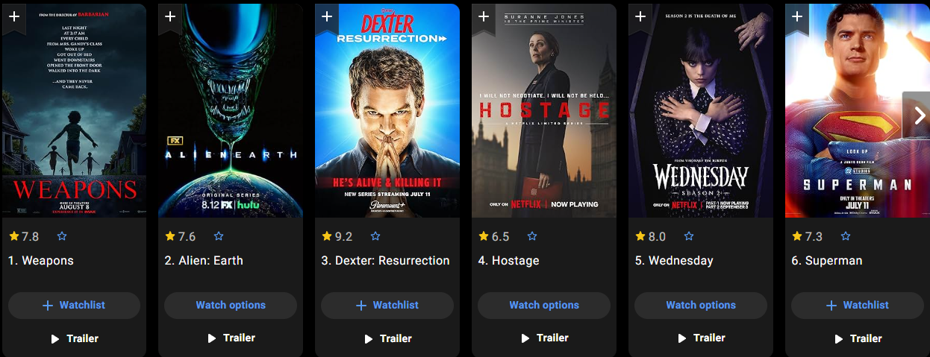
Motivation / Problem
Online reviews = massive data
Hard to manually analyze sentiment & patterns
Need: automatic system for sentiment + summaries + insights

Slide 3

Dataset
IMDb Dataset (50K reviews from Hugging Face)
Custom JSON reviews file
Balanced across positive, negative, neutral

Slide 4

Approach / Workflow
User → React Frontend → Flask Backend → ML/NLP models → Results (sentiment, summary, dashboard)

Slide 5

Sentiment Analysis
01
Primary: Transformer-based sentiment model (Hugging Face)
02
Fallback: TextBlob (if model unavailable)
03
Labels: positive / neutral / negative

Slide 6

Summarization
GPT-powered review summarizer (OpenAI API)
Fallback: TextBlob sentence extraction
Example:
Input: “Mind-bending and amazing!”
Output: “Overall, reviews highlight excitement and creativity.”

Slide 7
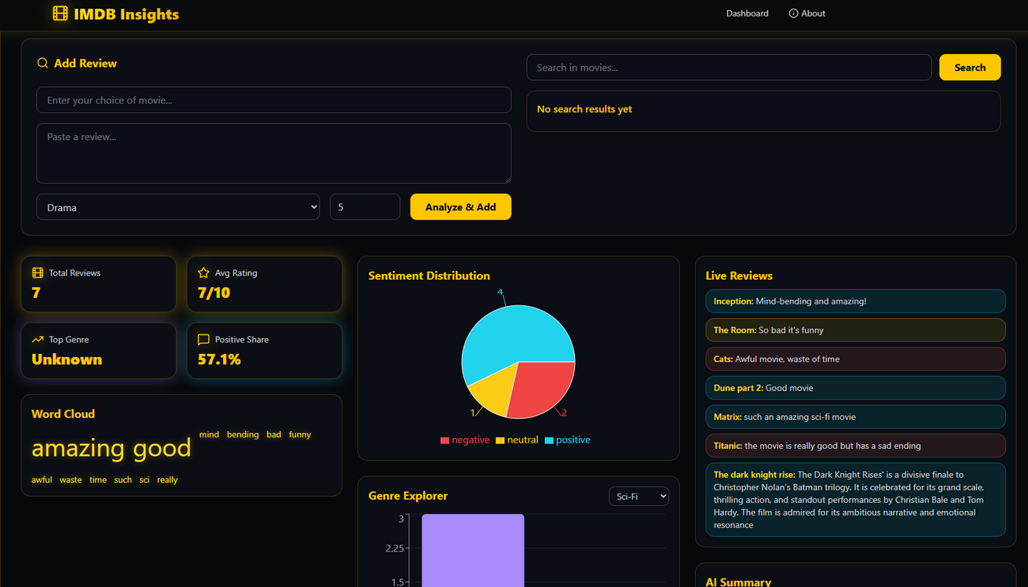




Dashboard Features
📊 Average rating
📌 Genre distribution
😀 Sentiment distribution
☁️ Word cloud of frequent terms

Slide 8
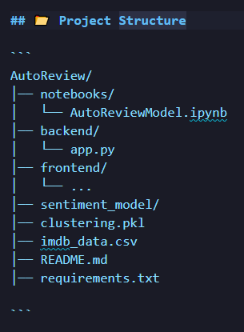
System Architecture
01
Notebook (training, testing models)
02
Flask (API + logic)
03
React (UI/Visualization)

Slide 9
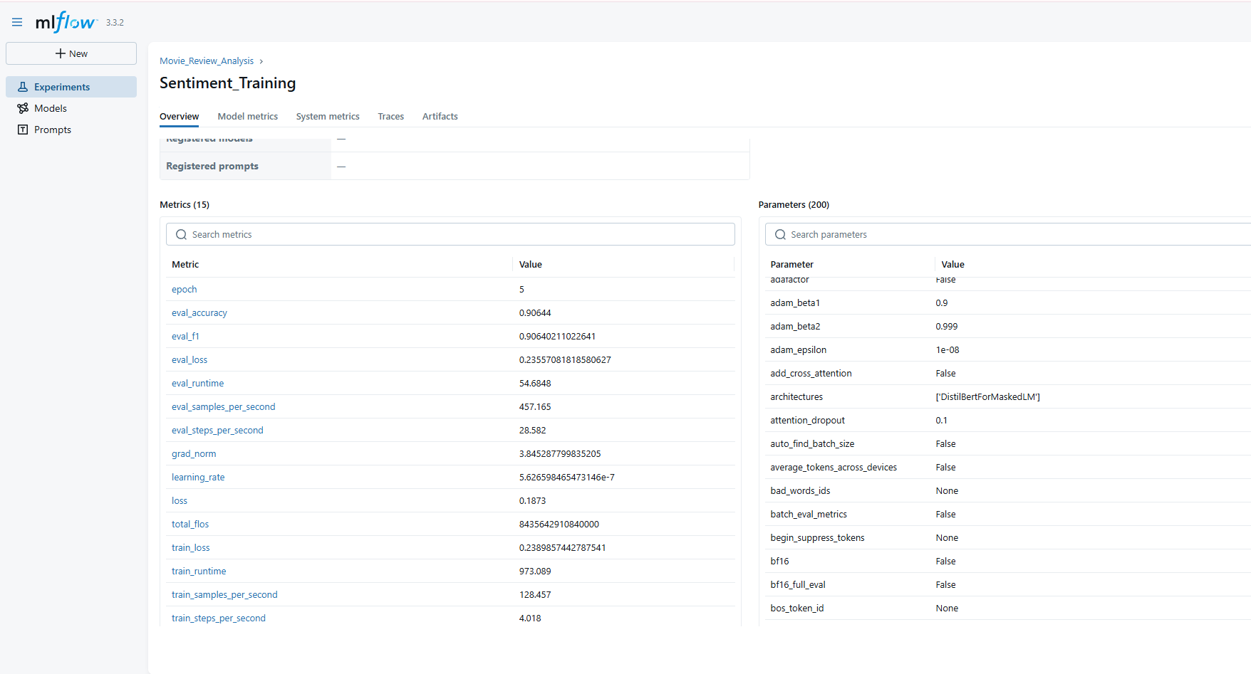
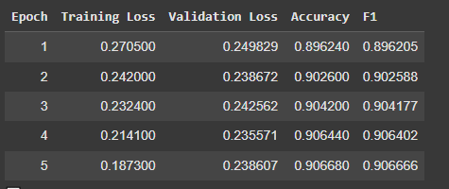
Results
Example output for review sentiment & summary
Sample dashboard screenshot (React)
Word cloud & charts

Slide 10
MLOps & MLflow for Experiment Tracking
MLOps ensures reproducibility, scalability, and continuous improvement in ML projects.
MLflow was used for:
📊 Tracking experiments, parameters, and metrics.
📦 Managing models and versions.
🔄 Reproducible training & evaluation.
Benefit: Makes the project production-ready with experiment management and smooth collaboration.

Slide 11

Challenges
Environment setup (API key issues, model loading)
Large dataset handling
GPT quota / fallback strategy

Slide 12
Conclusion
End-to-end system built ✅
Automates review analysis ✅
Combines ML + LLM + Web stack ✅

